Slide 1
Lexical Complexity Prediction
CS59000-14 Natural Language Processing
Fall 2022
Adhiviraj Singh Bangari
Winnie Har

Slide 2
What?

Slide 3
What is Lexical Complexity anyway?
Lexical: relating to the words or vocabulary of a language
a.k.a Language complexity
Can be:
Phonological - related to speech sounds
Morphological - related to forms of words, in particular inflected forms
Syntactic - related to the syntax of words
Semantic - related to the meaning of a word, phrase, or text
Notes:
Lexical complexity can be divided into several sub topics such as phonological which is a study of how languages organizes their sounds,
Morphological - which is a study of how words are formed and their relationship with other words in the same language
Syntactic - a study of how the smallest meaningful constituent of a linguistic expression combines to form larger units such as phrases and sentences
Semantic - study of reference, meaning, or truth

Slide 4
Why?
Lexical complexity plays a crucial role in reading comprehension.
Predicting lexical complexity accurately can enable a system to better guide a user to an appropriate text, or tailor a text to a user’s needs.
Eg, systems have been developed to simplify texts for second language learners, native speakers with low literacy levels, and people with reading disabilities.
Building block for other natural language processing (NLP) tasks.
Notes:
LCP is an extension to CWI (complex word identification) which is the task of deciding which word in a given sentence should be simplified. LCP is also a building block for other NLP tasks such as machine translation and text simplification.
English is also the official language of over 80 sovereign states and non-sovereign entities all over the world, and is the working language of many international organization. However, second language learners like many of us here may face diminishing motivation to learn if we encounter complex words. So if the complex words can be automatically identified and a synonym is added to it, it will definitely improve readability and the learning experience of English learners.

Slide 5
Task & Dataset

Slide 6
Task
To predict the complexity value of words in context.
Likert Scale points (with continuous scale threshold in brackets):
Very Easy (0): Words which were very familiar to an annotator
Easy (0.25): Words with which an annotator was aware of the meaning
Neutral (0.5): A word which was neither difficult nor easy
Difficult (0.75): Words which an annotator was unclear of the meaning, but may have been able to infer the meaning from the sentence.
Very Difficult (1): Words that an annotator had never seen before, or were very unclear.
Notes:
This topic is taken from SemEval 2021 task 1 and it consists of 2 sub tasks. Sub task 1 focuses on predicting the complexity of a single word while sub task 2 is for multiword expression. But for the purpose of this project we will only be looking at sub task 1.
Essentially what we need to do here is given a sentence and a word within the sentence, we need to predict how complex the word is. And the complexity score is based on the Likert Scale points, with 0 to 0.25 classified as very easy word, 0.25 to 0.5 as an easy word and so on.

Slide 7
Dataset
Augmented version of CompLex, a multi-domain English dataset with sentences annotated using a 5-point Likert scale (1-5) described in Shardlow et al. (2020)
Includes text from:
The World English Bible translation - no archaic words, contains religious language which may be complex
English portion of the European Parliament proceedings - varied corpus talking about european policy
Select articles from CRAFT corpus, which are from the biomedical domain. These present a very specialised type of language that will be unfamiliar to non-domain experts.
Notes:
The dataset provided consists of text from 3 domains. Texts from the English bible, european parliament proceedings and the biomedical domain.
These domains are highly specialized so for readers who are not in the particular field it may be quite challenging to figure out the meaning of the word.

Slide 8
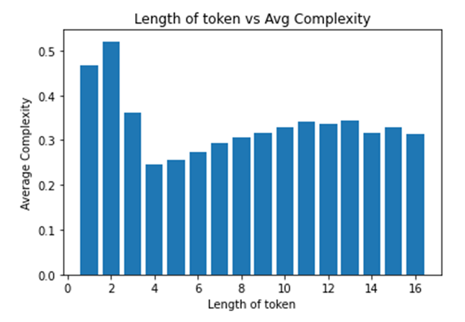
Dataset
 | Training | Test
Biblical text | 2,574 | 283
Biomedical articles | 2,576 | 289
Euro Parl Proceedings | 2,512 | 345
Total | 7,662 | 917
Notes:
We tried looking into the dataset before starting to work on the task. We found that some of the tokens to be predicted are not words that you would find in the dictionary.
Some are short forms like NL and ADAM, scientific words like hg and Tg, and even roman numeral, Va. Initially we considered using the simplest way, that is to predict the complexity using the length of the token but when we look at this chart on the left, the shorter tokens actually have higher average complexity than the longer tokens so we know using the length of the tokens is not a good idea.
And on the right we can see the distribution of our dataset is quite evenly distributed across the 3 domains.

Slide 9
Approaches

Slide 10
Approaches
Strip contractions, remove numbers and special characters. Logistic Regression model on reduced dataset for preliminary research
Preprocess using TF-IDF (lower-case and remove stop words using NLTK stop word list) 4 SGDClassifier models, 1 for each domain and 1 on full dataset
PreTrainedTokenizerFast embeddings and taking outputs of the last 4 layers Neural network with 4 fully connected layers
PreTrained BertTokenizer (bert-large-uncased) Fine-tuned BertForSequenceClassification (bert-large-uncased)

Slide 11
SGD Classifier
<analysis + running results>
Using the Scikit-learn’s SGD Classifier model
Model Dataset | Bible (Acc/r2_score) | Biomel (Acc/r2_score) | Europarl (Acc/r2_score) | Full (Acc/r2_score)
Bible | 0.396,-1.10 |  |  | 0.374,-1.05
Biomed |  | 0.377,-1.11 |  | 0.353,-1.30
Europarl |  |  | 0.513,-1.03 | 0.458,-1.34
Full |  |  |  | 0.399,-1.21
Notes:
Here are the results from our SGD Classifier model. We can see here the results are really bad. If we look at models trained on partial dataset, the highest accuracy is only slight above 50%. Whereas for the full model, the highest accuracy is on the europarl domain test data and it’s not even 50% accurate. One thing to note is that the r2_scores here are all negative. Even a horizontal line will give better results than our model.

Slide 12
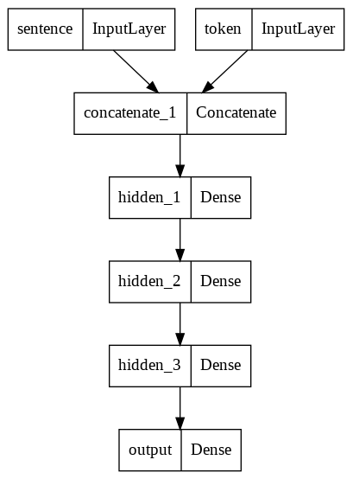
Neural Network
<analysis + running results>
Using Keras’ functional API to build neural network
 | Acc | R2_score
Neural Network | 0.613 | -2.65 * 10^-6

Slide 13
Linear Regression
 | Pearson’s R | R2 | MSE | MAE
Linear Regression | 0.379 | 0.003 | 0.017 | 0.102
<analysis + running results> Using the Scikit-learn’s Linear Regression model

Slide 14
BERT
Epoch | Pearson’s R | Spearman’s Rho | R2 | MSE | MAE
1 | 0.730 | 0.700 | 0.533 | 0.008 | 0.069
2 | 0.750 | 0.717 | 0.563 | 0.007 | 0.068
3 | 0.755 | 0.724 | 0.570 | 0.007 | 0.067
4 | 0.750 | 0.714 | 0.563 | 0.007 | 0.067
5 | 0.747 | 0.714 | 0.559 | 0.008 | 0.071
6 | 0.749 | 0.715 | 0.561 | 0.008 | 0.071
7 | 0.737 | 0.706 | 0.543 | 0.009 | 0.074
<analysis + running results>
Using the pretrained BERT (bert-base-uncased) model from Huggingface
Notes:
Brief background about the BERT model used here.
Talk about metrics improving over epochs and the falling.

Slide 15
Overall Results
SemEval official results
Rank | Pearson | Spearman | MAE | MSE | R2
1 | 0.7886 | 0.7369 | 0.0609 | 0.0062 | 0.6172
2 | 0.7882 | 0.7425 | 0.0610 | 0.0061 | 0.6210
… | … | … | … | … | …
31 | 0.7509 | 0.7086 | 0.0649 | 0.0072 | 0.5536
32 | 0.7503 | 0.7180 | 0.0652 | 0.0073 | 0.5477
Team PFW | 0.7492 | 0.7156 | 0.0707 | 0.0082 | 0.5613
33 | 0.7482 | 0.7237 | 0.0649 | 0.0072 | 0.5525
Notes:
Since this topic is from a past SemEval test, we have a benchmark that we can compare against. Based on the current results that we have, we would rank at 32 for this task.

Slide 16
Conclusion
There are many potential use cases and applications using LCP
Helps downstream NLP related tasks
Extension to other languages
Multilingual LCP, Cross-lingual LCP
Notes:
LCP remains as an area of interest because of its many potential use cases and applications using. If a reliable system can be built, it could help in assistive technologies for learning
LCP can also be integrated with other downstream NLP tasks like machine translation and lexical simplification.
There’s also ongoing LCP research in other languages such as French, German, Chinese and Japanese.

Slide 17
What’s next?
Future work:
Try Open AI’s GPT-2 model
Investigate how preprocessing the text effects model accuracy

Slide 18
References
https://sites.google.com/view/lcpsharedtask2021
https://aclanthology.org/2021.semeval-1.1.pdf
https://arxiv.org/pdf/1810.04805.pdf (BERT: Pre-training of Deep Bidirectional Transformers for Language Understanding)
https://dl.acm.org/doi/pdf/10.1145/3557885

